Slide 1
TEXTURES
László Szécsi
szecsi@iit.bme.hu

Slide 2
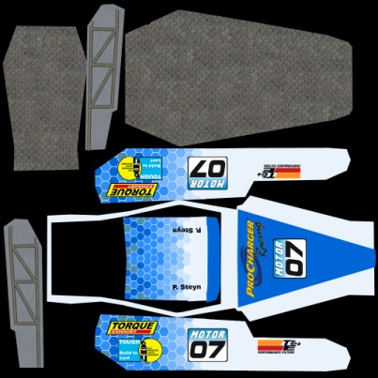
Texture interpretations
image in memory
like the frame buffer
pixels are called texels
array of data
1D, 2D, 3D arrays
RGB records
discreet sample points on a grid
reconstruction: filtering
R
G
B
R
G
B
R
G
B
R
G
B
R
G
B
R
G
B

Slide 3
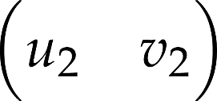
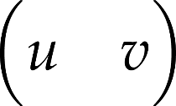
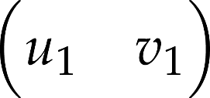
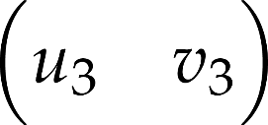



Textúraleképezés
color
texture coordinates from vertex buffer
Notes:
If texture mapping is enabled with glEnable(GL_TEXTURE_2D) texture coordinates are interpolated during rasterization, and the pixel color will be the color fetched from the texture image using the interpolated texture coordinates as an address. The color interpolated from the colors of the vertices is either ignored in replacing texture environment mode, glTexEnvi(GL_TEXTURE_ENV, GL_TEXTURE_ENV_MODE, GL_REPLACE),
or multiplied with the texture color in modulating texture environment mode, glTexEnvi(GL_TEXTURE_ENV, GL_TEXTURE_ENV_MODE, GL_MODULATE).
OpenGL may simultaneously store many textures, so we should select which texture to be applied or which texture is to be modified by glBindTexture(GL_TEXTURE_2D, id), where id is the integer identifier of the texture.

Slide 4
Texture creation (in Texture2D.kt)
glTexture = gl.createTexture()
image = Image()
//after loading
gl.bindTexture(GL.TEXTURE_2D, glTexture)
gl.texImage2D(GL.TEXTURE_2D, 0,
GL.RGBA, GL.RGBA,
GL.UNSIGNED_BYTE, image)

Slide 5
Texturing fragment shader
in vec2 texCoord;
uniform struct{
sampler2D colorTexture;
} material;
void main(void) {
fragmentColor =
texture(material.colorTexture, texCoord);
}

Slide 6
Binding the texture to a uniform (in webglmath.Sampler2D)
val samplerLocation =
gl.getUniformLocation(
glTexturingProgram, "material.colorTexture")
gl.uniform1i(samplerLocation, 0)
gl.activeTexture(GL.TEXTURE0)
gl.bindTexture(GL.TEXTURE_2D, glTexture)

